Slide 1
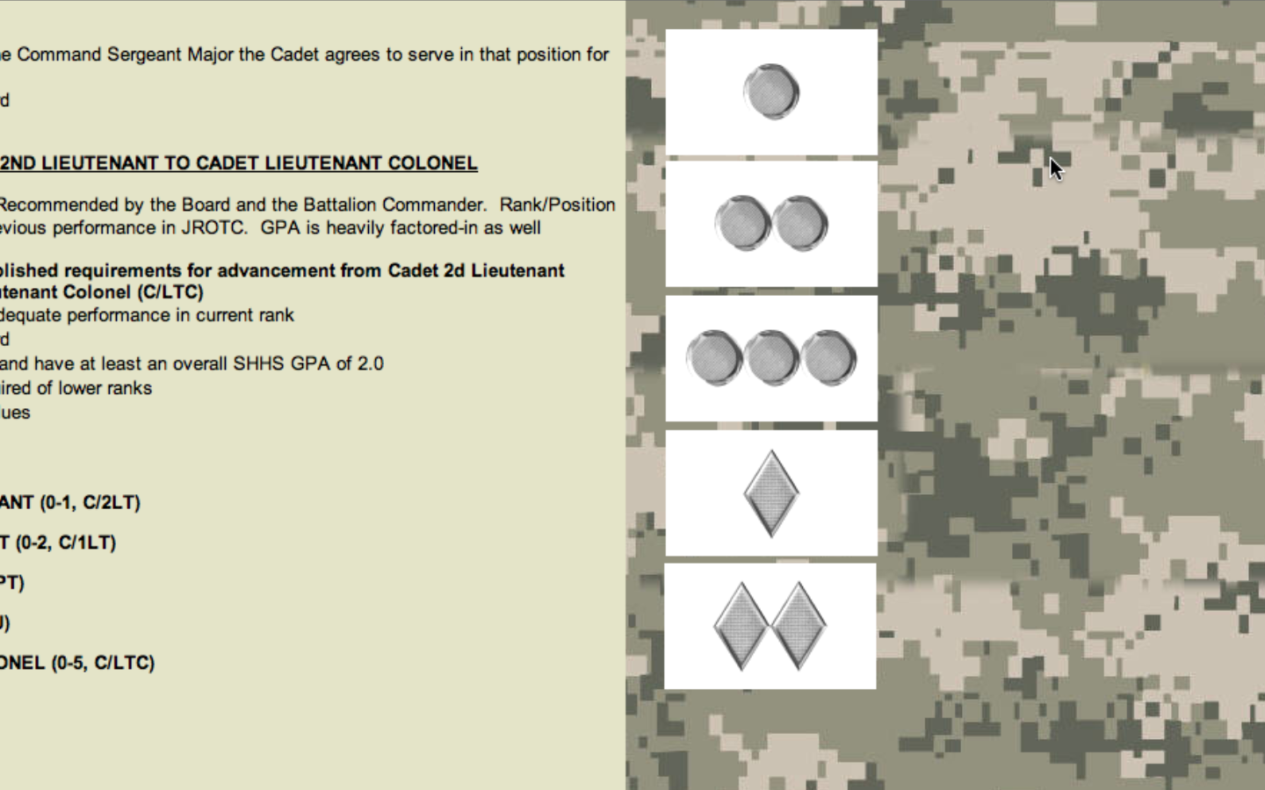
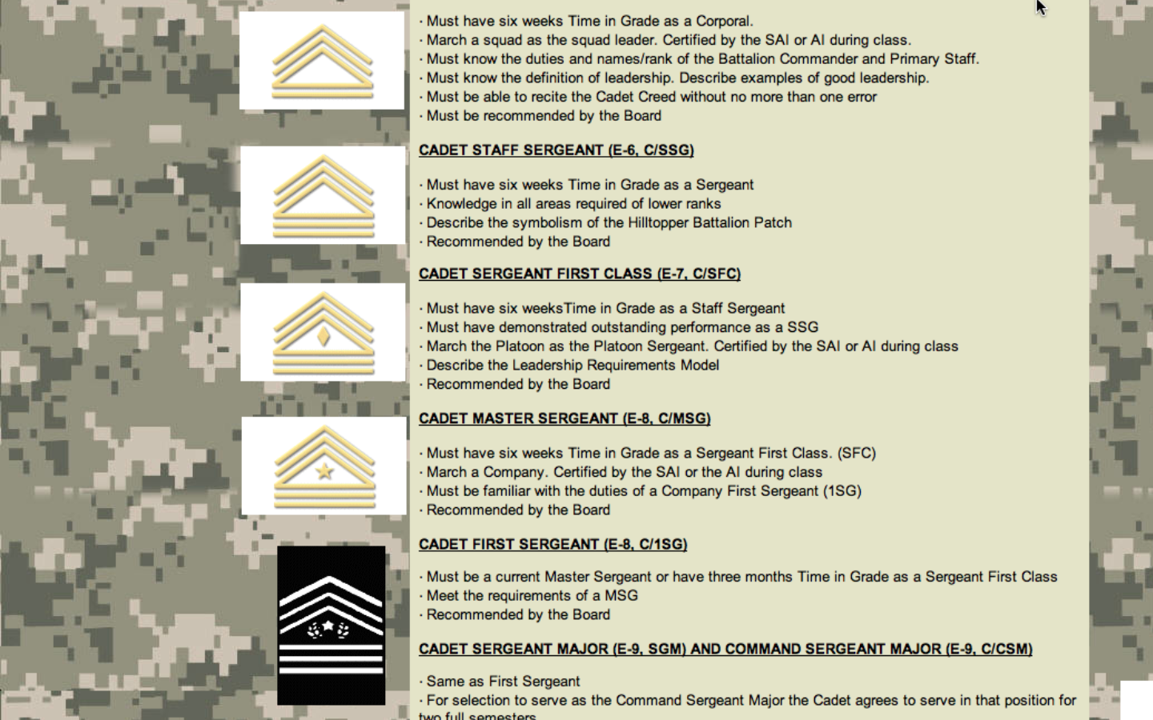
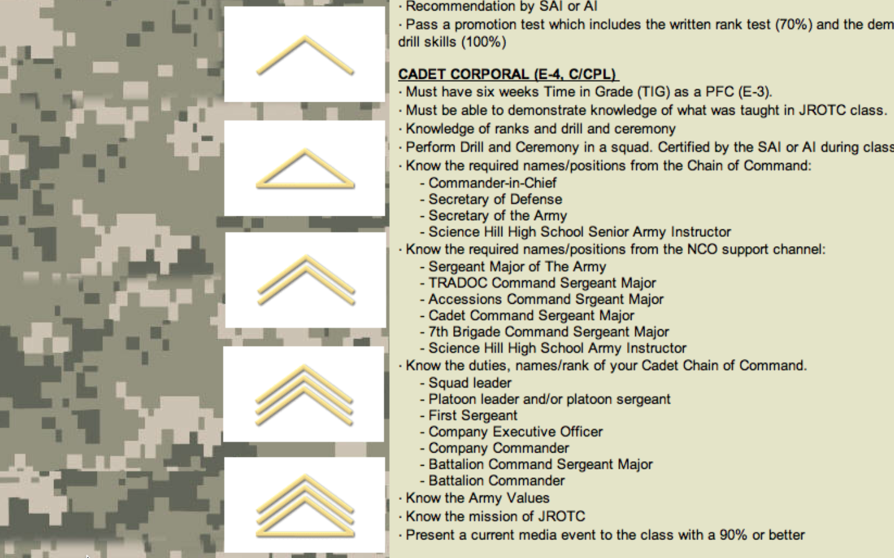
Grade: 9th / 10th / 11th / 12th (Circle)
Memorandum For: Colonel Johnson
Master Sergeant Ross
From: Cadet (Rank & Name) ___________________
Date of Cadet Agreement: _________________(DD/MM/YEAR)
Name of Course: _____________
Name of Teacher: ____________
Academic performance in all classes is key for promotion in JROTC is academic performance.
A passing grade or better in all classes (as noted in PowerTeacher or a note from the teacher) is required at time of promotion.
The most important element of our daily JROTC Study Hall opportunity is for Cadets to fully leverage available respective academic departmental tutoring.
Below is my plan to raise my grade to an acceptable level.
Is tutoring available to me from the teacher or respective department? Yes / No (circle one)
If tutoring is available, what days of the week and times of the day is tutoring available? _________________________________________
If tutoring is available, I will / will not (circle one) participate. If so, when and where? ______________________________________________ If not, why not?
After discussing my current semester average with my teacher, my plan to raise my grade to at least a passing average as quickly as possible is:
Note to teachers from Colonel Johnson - - “I welcome any suggestions you have that I can implement which will help the performance of my Cadets in your class

